Slide 1
Voltage profile and VAR compensation

Slide 2
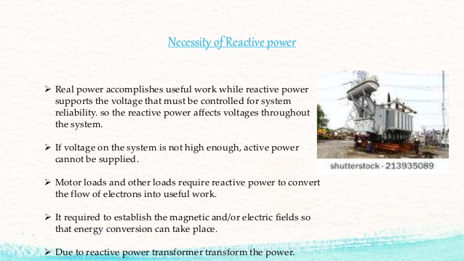

Slide 3
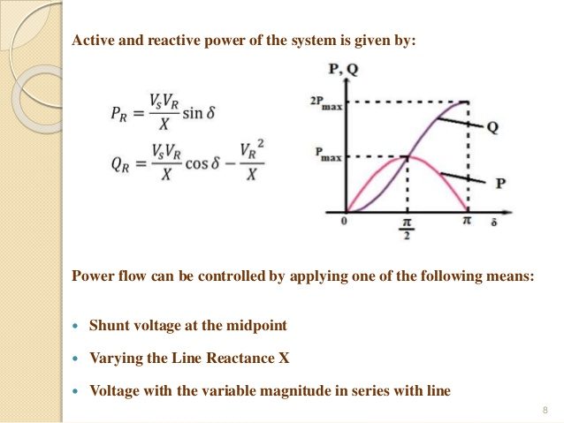

Slide 4
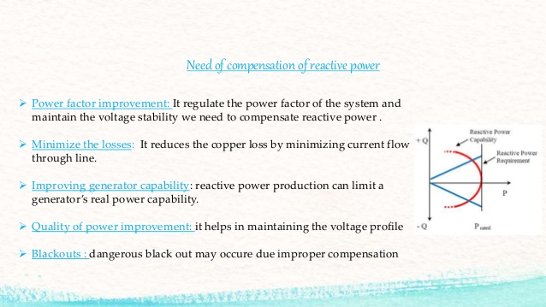

Slide 5
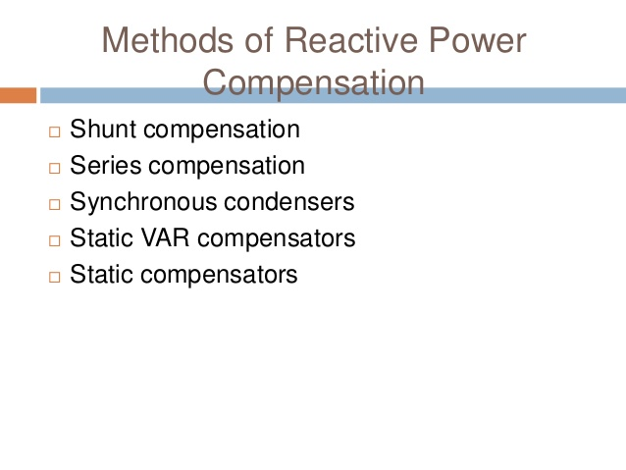

Slide 6
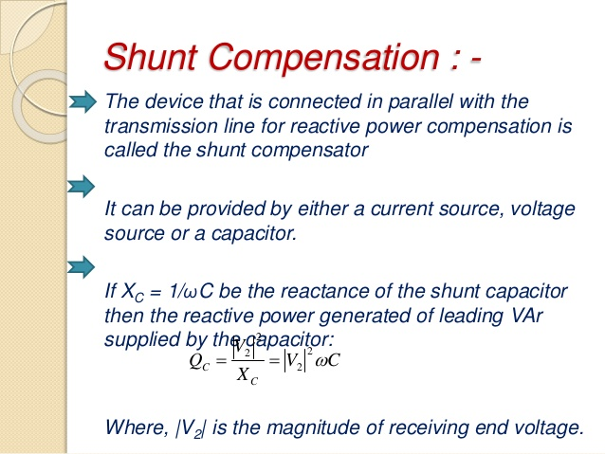

Slide 7
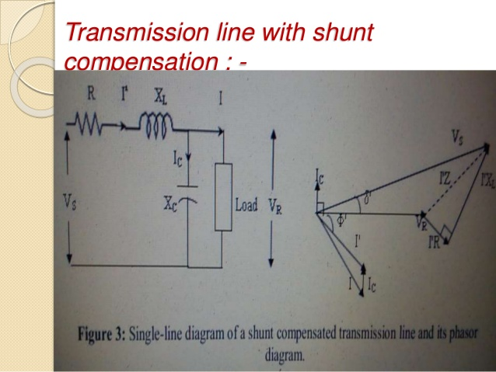

Slide 8
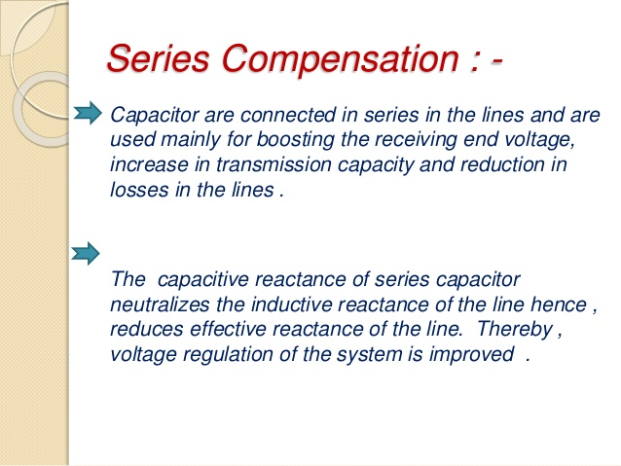

Slide 9
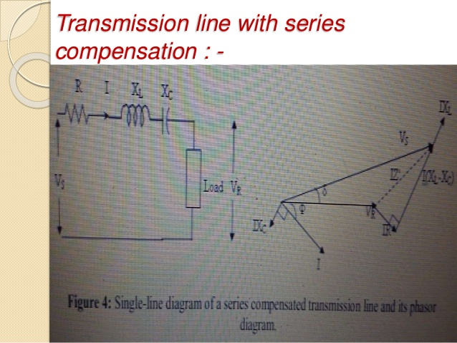

Slide 10
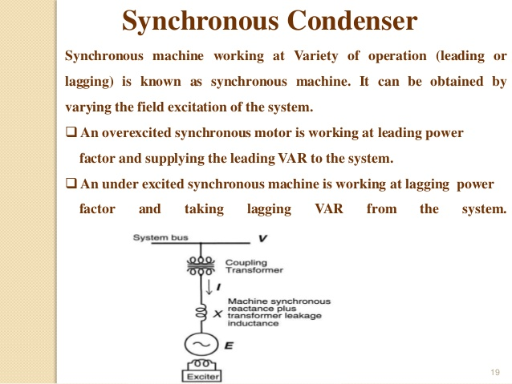

Slide 11
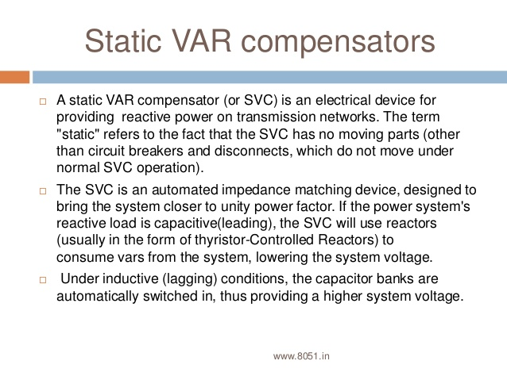

Slide 12
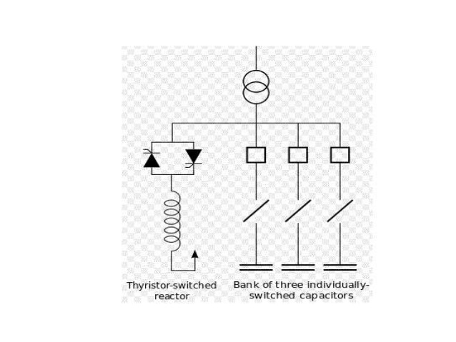

Slide 13
STATCOM/ (STATIC SYNCHRONOUS COMPENSATOR)

Slide 14
STATCOM or Static Synchronous Compensator is a power electronic device using force commutated devices like IGBT, GTO etc. to control the reactive power flow through a power network and thereby increasing the stability of power network.
It is also a member of the so-called Flexible AC Transmission System (FACTS) devices.
The terms Synchronous in STATCOM mean that it can either absorb or generate reactive power in synchronization with the demand to stabilize the voltage of the power network.

Slide 15
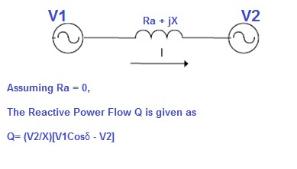
Working Principle of STATCOM
To understand the working principle of STATCOM, we will first have a look at the reactive power transfer equation.
Let us consider two sources V1 and V2 are connected through an impedance Z = Ra + jX as shown in figure below.

Slide 16
if we maintain angle δ = 0 then
Reactive power flow will become Q = (V₂/X)[V₁-V₂]
And active power flow will become P = V₁V₂Sinδ / X =0
To summarize, we can say that if the angle between V₁ and V₂ is zero, the flow of active power becomes zero and the flow of reactive power depends on (V₁ – V₂). Thus for flow of reactive power there are two possibilities.
1) If the magnitude of V₁ is more than V₂, then reactive power will flow from source V₁ to V₂.
2) If the magnitude of V₂ is more than V₁, reactive power will flow from source V₂ to V₁.
This principle is used in STATCOM for reactive power control. Now we will discuss about the design of STATCOM for better correlation of working principle and design.

Slide 17
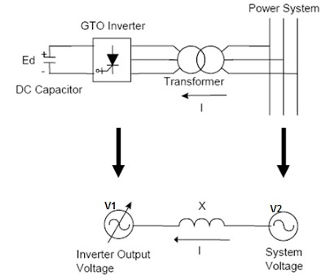
Design of STATCOM
GTO-based STATCOM Simple Diagram

Slide 18
A STATCOM is composed of the following components:
A. Voltage-Source Converter (VSC) :The voltage-source converter is used to convert the DC input voltage to an AC output voltage. Two of the common VSC types are as below.
a) Square-wave Inverters using Gate Turn-Off Thyristors: In this type of VSC, output AC voltage is controlled by changing the DC capacitor input voltage, as the fundamental component of the converter output voltage is proportional to the DC voltage.
b) PWM Inverters using Insulated Gate Bipolar Transistors (IGBT): It uses Pulse Width Modulation (PWM) technique to create a sinusoidal waveform from a DC voltage source with a typical chopping frequency of a few kHz. In contrast to the GTO-based type, the IGBT-based VSC utilizes a fixed DC voltage and varies its output AC voltage by changing the modulation index of the PWM modulator.
B. DC Capacitor: This component provides the DC voltage for the inverter.
C. Inductive Reactance (X) :It connects the inverter output to the power system. This is usually the leakage inductance of a coupling transformer.
D. Harmonic Filter: Harmonic Filter attenuates the harmonics and other high frequency components due to the VSC.

Slide 19
STATCOM Operation/Basic Principle of Operation
STATCOM can be used to regulate the reactive power flow by changing the output voltage of the voltage-source converter with respect to the system voltage.
The STATCOM can be operated in two different mode
1) Voltage Regulation Mode: The static synchronous compensator regulates voltage at its connection point by controlling the amount of reactive power that is absorbed from or injected into the power system through a voltage-source converter.
In steady-state operation, the voltage V₂ generated by the VSC through the DC capacitor is in phase with the system voltage V₁ (δ=0), so that only reactive power (Q) is flowing (P=0).
When system voltage is high, the STATCOM will absorb reactive power (inductive behavior).
When system voltage is low, the STATCOM will generate and inject reactive power into the system (capacitive).

Slide 20
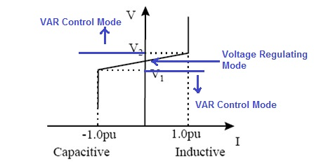
2) VAR Control Mode :In this mode, the STATCOM reactive power output is kept constant independent of other system parameter . If the voltage of power system goes below V1 or above V2, STATCOM acts in VAR Control mode.

Slide 21
